Slide 1
HOTEL RESERVATION DATA ANALYSIS
BY- Hemanth Basapuram Gandla
BATCH- MIP-DA-08

Slide 2


The Strategic Value of Data Analysis in Business Operations

Slide 3

Introduction
Welcome to the presentation on the strategic value of data analysis in business operations.
This presentation will explore the critical role of data analysis in driving strategic decision making and operational efﬁciency in today’s business landscape.

Slide 4







Data Analysis in Business
Data analysis plays a crucial role in
,
, and .
By leveraging data, businesses can gain valuable insights to drive
and .

Slide 5



Operational Efficiency
Effective data analysis enables businesses to streamline operations,
, and
By leveraging data-driven insights, organizations can make informed decisions to
and deliver superior value to customers.
.

Slide 6





Strategic Decision- Making
Data analysis empowers
by providing actionable insights into market trends,
customer behavior, and competitive landscape. With data-driven intelligence, businesses can make informed decisions to
and mitigate risks.

Slide 7
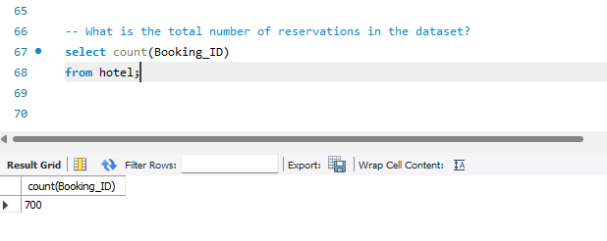
1. What is the total number of reservations in the dataset?
Total Reservations 700

Slide 8
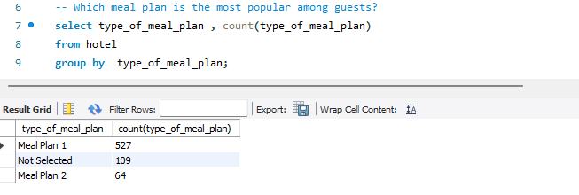
2. Which meal plan is the most popular among guests?
Meal plan is the most popular plan with 527 meals taken
Followed by no meal and meal 2 selectively

Slide 9
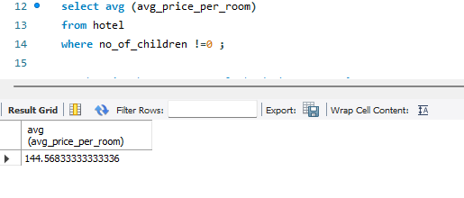
3. What is the average price per room for reservations involving children?
Average price of the room without children is 144.5683

Slide 10


4. How many reservations were made for the year 20XX (replace XX with the desired year)?
Total bookings in 2018 are 577

Slide 11
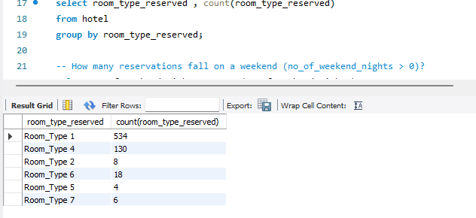
5. What is the most commonly booked room type?
Most common room type is Room_Type_1 with a count of 534 rooms

Slide 12
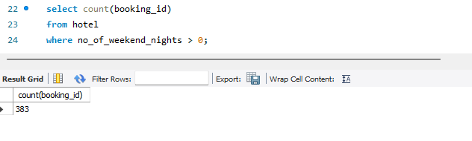
6. How many reservations fall on a weekend (no_of_weekend_nights > 0)?
383 reservations were done where weekend nights were more than 0

Slide 13
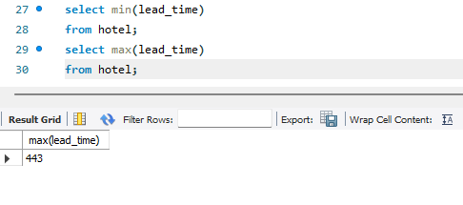
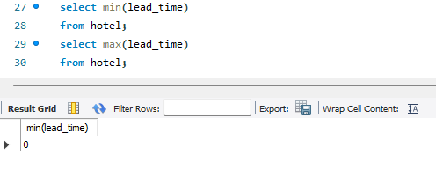
7. What is the highest and lowest lead time for reservations?
443 is the highest lead time for reservation
0 is the lowest lead time for reservation

Slide 14
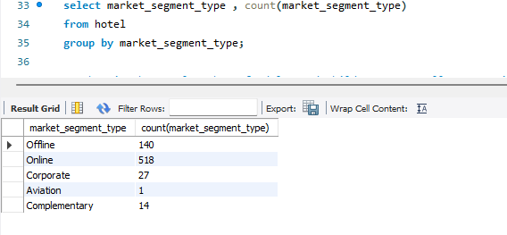
8. What is the most common market segment type for reservations?
The most most common market segment type for reservations is online with 518 reservations

Slide 15
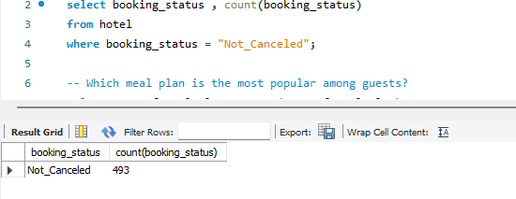
9. How many reservations have a booking status of "Confirmed"?
493 bookings stand confirmed

Slide 16
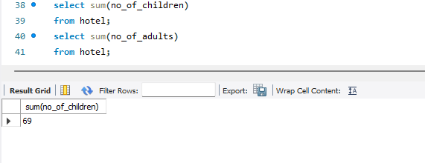
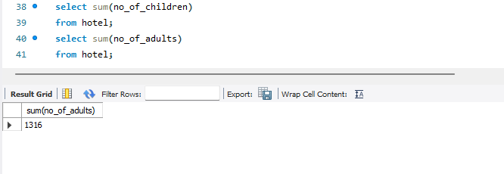
10. What is the total number of adults and children across all reservations?
1316+69 = 1385

Slide 17
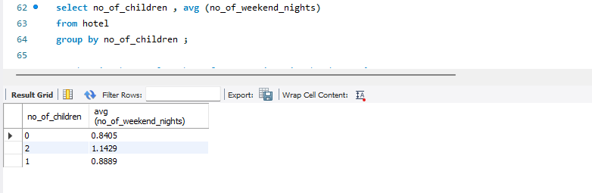
11. What is the average number of weekend nights for reservations involving children?
0 children 0.8405 is the average price
1 child 0.889 is the average price
2 children 1.1429 is the average price

Slide 18
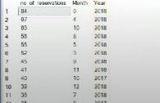
12. How many reservations were made in each month of the year?

Slide 19
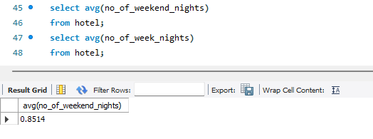
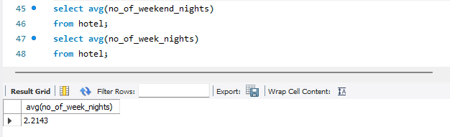
13. What is the average number of nights (both weekend and weekday) spent by guests for each room type?

Slide 20
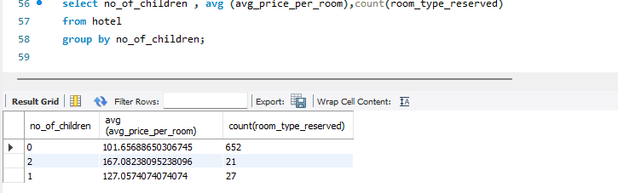
14. For reservations involving children, what is the most common room type, and what is the average price for that room type?

Slide 21
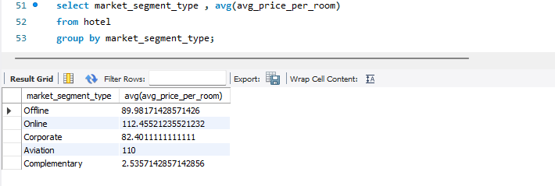
15. Find the market segment type that generates the highest average price per room.
Online generates the highest average price per room of 112.4552

